Slide 1
Introduction to Artificial Intelligence
Litty Tressa George
Lecturer FICT
Section 1 PPT 4

Slide 2
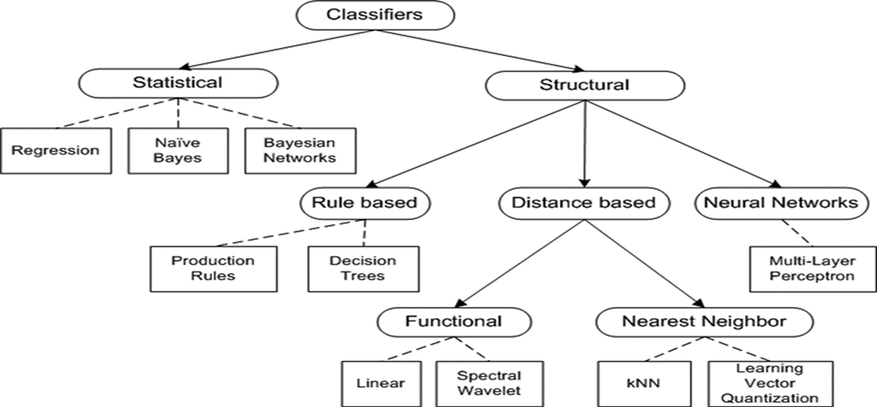
Machine Learning Classifiers

Slide 3
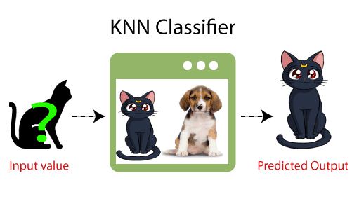
KNN- K Nearest Neighbour Algorithm

Slide 4
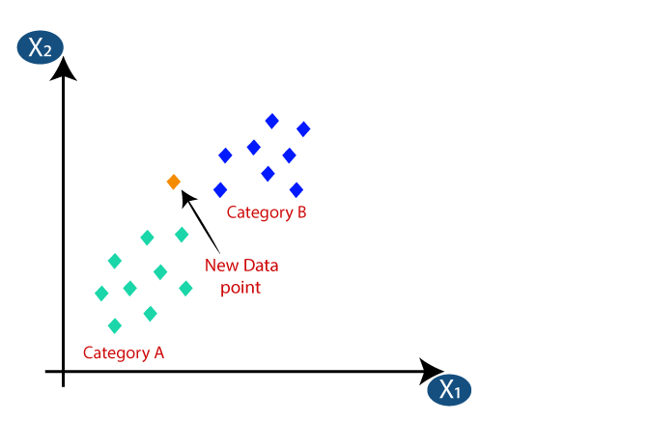
KNN Representation

Slide 5
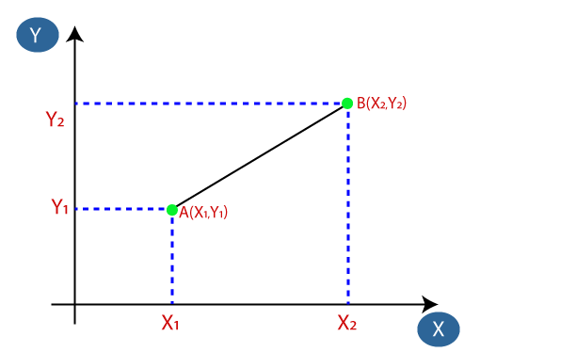

Distance Calculation

Slide 6
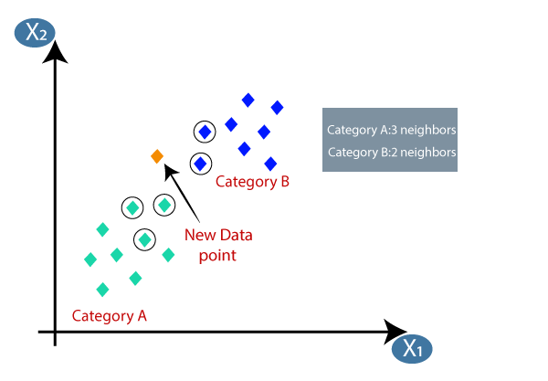
KNN Classification
Assign the new data points to that category for which the number of the neighbour is maximum.

Slide 7
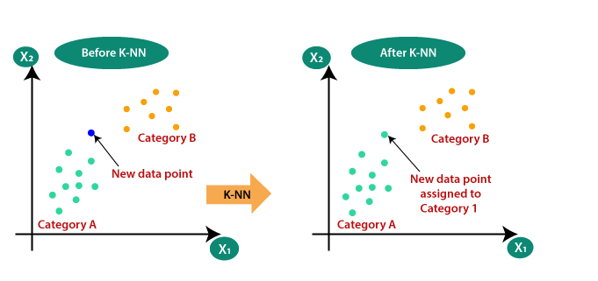

Slide 8
Decision Tree
It is one of the most widely used and practical methods for supervised learning.
Decision Trees are a non-parametric supervised learning method used for both classification and regression tasks.
In general, decision trees are constructed via an algorithmic approach that identifies ways to split a data set based on different conditions.
The goal is to create a model that predicts the value of a target variable by learning simple decision rules inferred from the data features.
The decision rules are generally in form of if-then-else statements.
The deeper the tree, the more complex the rules and fitter the model.

Slide 9
A decision tree is a tree-like graph with nodes representing the place where we pick an attribute and ask a question; edges represent the answers the to the question; and the leaves represent the actual output or class label.
Decision trees classify the examples by sorting them down the tree from the root to some leaf node, with the leaf node providing the classification to the example.
Each node in the tree acts as a test case for some attribute, and each edge descending from that node corresponds to one of the possible answers to the test case.
This process is recursive in nature and is repeated for every subtree rooted at the new nodes.

Slide 10
Example: Assume we want to play badminton on a particular day — say Saturday — how will you decide whether to play or not.
Factors to be considered: check if it's hot or cold, check the speed of the wind and humidity, how the weather is, i.e. is it sunny, cloudy, or rainy.
You have to take all these factors into account to reach a decision ie to Play Or Not.

Slide 11
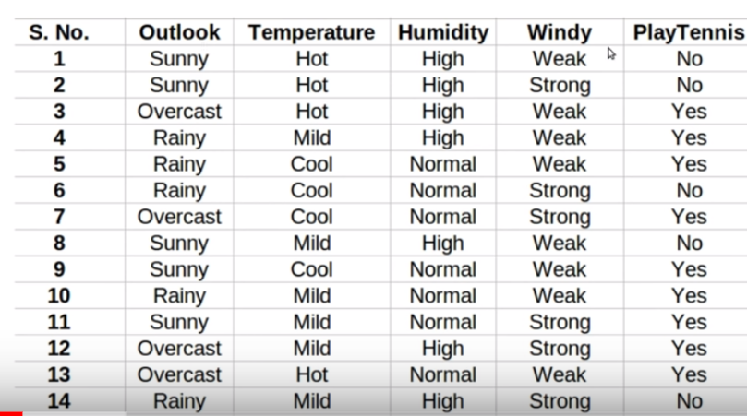
Tabulated Data Set on the basis of various impact factors

Slide 12
Can this table to decide whether to play or not ?
But, what if the weather pattern on Saturday does not match with any of rows in the table? This may be a problem.

Slide 13
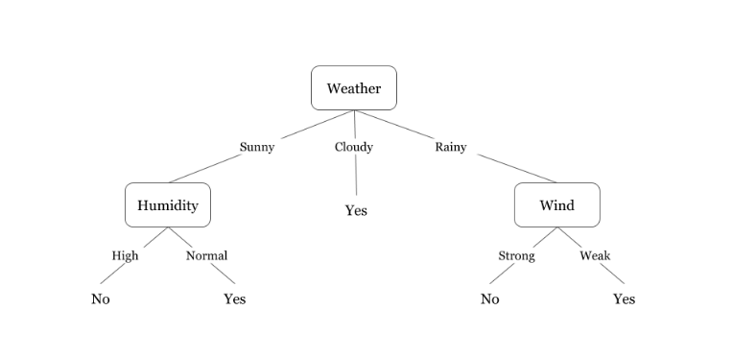
Fig: A decision tree for the concept play tennis/ badminton

Slide 14
The Fig 1 illustrates a learned decision tree.
We can see that each node represents an attribute or feature and the branch from each node represents the outcome of that node.
Finally, its the leaves of the tree where the final decision is made.
If features are continuous, internal nodes can test the value of a feature against a threshold (see Fig. 2).

Slide 15
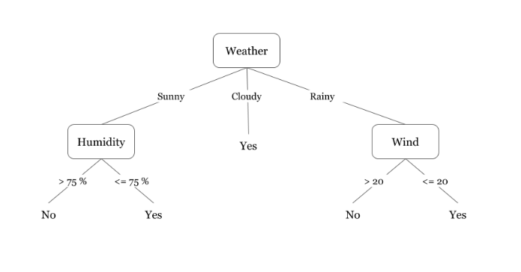
Slide Title
Fig 2. A decision tree for the concept Play Badminton (when attributes are continuous)

Slide 16
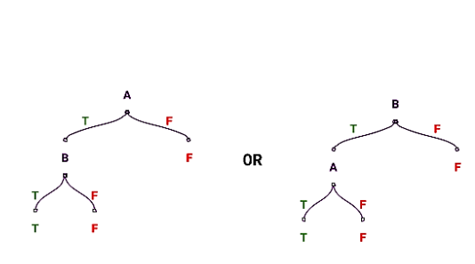
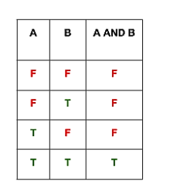
Expressiveness Of Decision Trees
Boolean Function: AND
Fig 3. Decision tree for an AND operation.

Slide 17
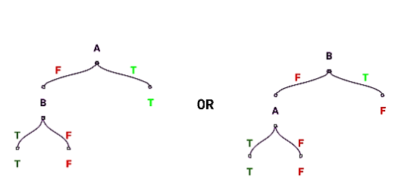
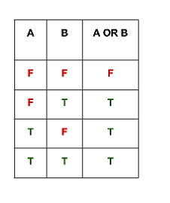
Boolean Function: OR
Fig 4. Decision tree for an OR operation

Slide 18
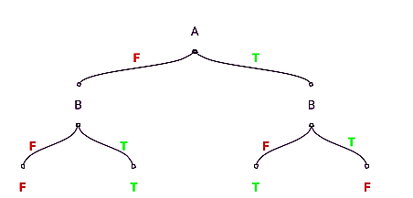
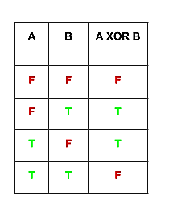
Boolean Function: XOR
Fig 5. Decision tree for an XOR operation

Slide 19
Activity
Draw a decision tree performing XOR functionality using 3 attributes X1, X2, X3

Slide 20
These are the main algorithms to build a decision tree.
CART (Classification and Regression Trees) — This makes use of Gini impurity as metric.
ID3 (Iterative Dichotomiser 3) — This uses entropy and information gain as metric.

Slide 21
Decision Tree using ID3- Example
Here there are four independent variable to determine the dependent variable.
The independent variables are outlook, temperature, humidity, and wind.
The dependent variable is whether to play football or not.

Slide 22
Choose the Root Node
As the major step, we have to find the parent node for our decision tree.
For that we have to find the entropy of class variable.

Slide 23
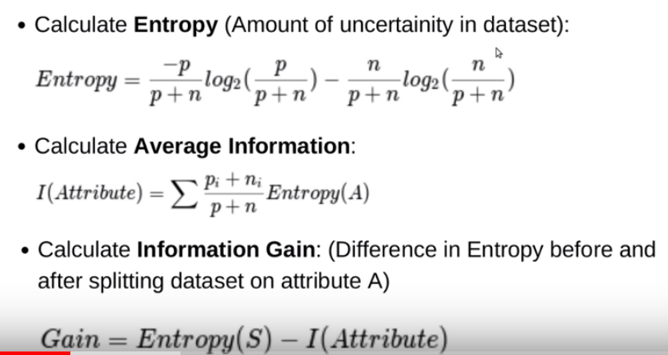

Slide 24

Slide Title

